Slide 1
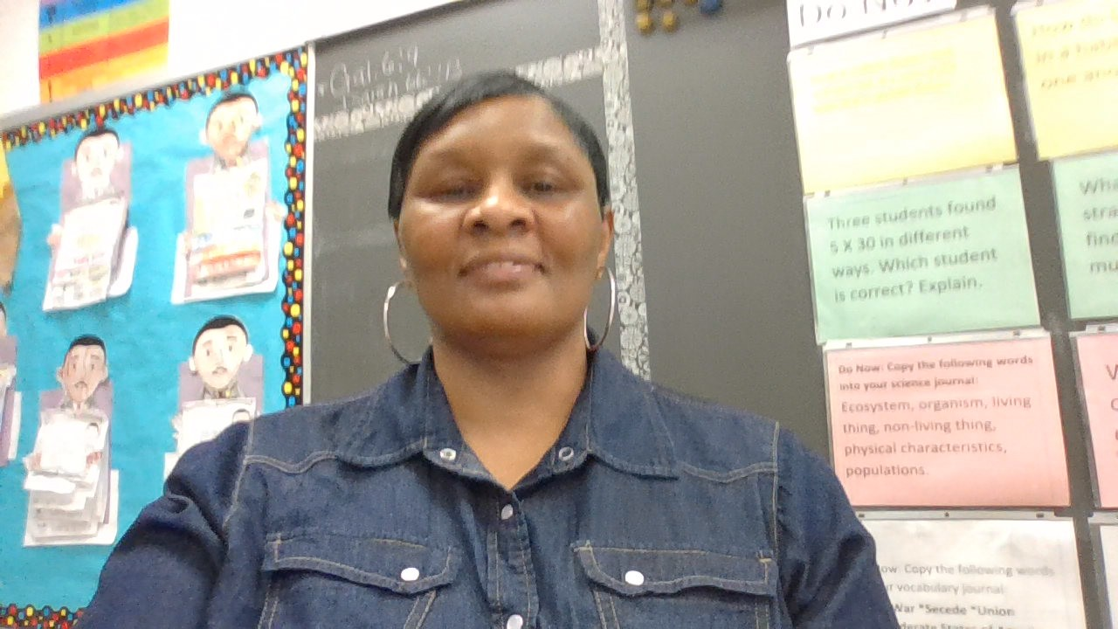
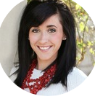
Ms. Beard
About Me
Welcome to 3rd Grade!
I am pleased to welcome you to the new school year! I am looking forward to having your child as a student. Third grade is such a fun year with so many wonderful learning activities to celebrate. In order to have a fun year, my most important goal is to create a family of learners in my classroom. I am committed to creating a classroom environment where your child is a valued, trusted, and integral part of our family of learners. In order to accomplish this, I have planned a variety of activities to emphasize and reinforce this goal. It is my hope that you will support and encourage this vision at home.
Hello! I am Lita Beard your child’s third grade teacher. I have a Bachelor’s Degree in
Early Childhood form Harris Stowe-State University. This is my fourth year with Gateway. I have a total of 20 years plus years in education
Contact Me
My Favorites
I welcome and value parent involvement throughout the year. I would love to hear from you, and you are welcome to contact me with any questions, comments, or concerns you may have.
Food:
Fruit
Drink: Water
Candy: Gummy Bears
314-241-8255 Ext: 215
Hobby: Reading
Class DOJO
Book: Any
lita.beard @slps.com
Subject:
reading

